Slide 1
Medicare 101
Understanding the A,B,C & D’s of Medicare
2024

Slide 2
What is Medicare?
Medicare 101
Medicare is….
A federal health insurance program for eligible U.S. citizens and legal residents
Funded in part by taxes you pay while working
Individual health insurance
Medicare is not…
A family health plan
Social Security
Medicaid
Free

Slide 3
How long has Medicare been around?
1945
1955
1965
1975

Slide 4
How long has Medicare been around?
1945
1955
1965
1975
Notes:
If you chose 1965, you are correct! Medicare’s been around for just over 50 years. And It has evolved over that time! When Medicare 1st came into existence, it was really just for hospitalization. People were going bankrupt due to illness and having to sell everything they have, “sell the farm” to pay for Medical costs.

Slide 5
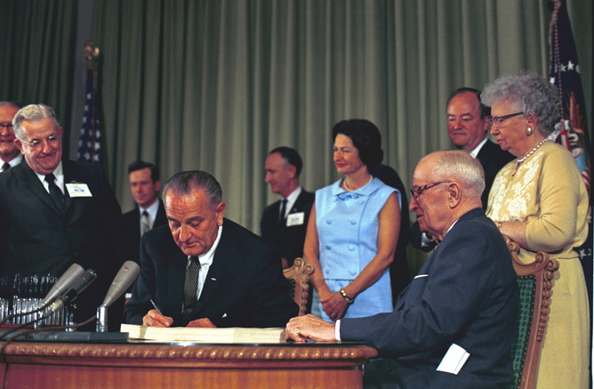
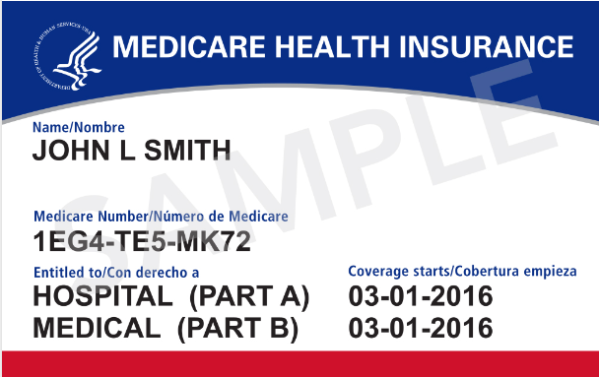
Medicare 101
Notes:
A little history – The Medicare Law was signed by President Lyndon Johnson in 1965, with Harry S Truman as witness. Truman was pushing the Medicare idea back in the 50’s during his administration. He couldn’t get it done during his Presidency, but he was witness to Johnson signing it, and fittingly, Truman and his wife were the first enrollee’s into Medicare.
There is the very patriotic Medicare card. Probably a familiar sight for most of you.
Due to concerns of identify theft and illegal use of Medicare benefits, CMS was required to remove SSN’s from all Medicare cards by April 2019.
Medicare ID’s began to transition in April 2018 from a claim number comprised of a SSN followed by a letter to a randomly generated identifier comprised of letters and numbers. This transition was completed in April 2019 and all Medicare recipients have been issued a new card with the newly formatted number.
(Historically your Medicare claim number was your SSN followed by a letter. So if you were claiming your own benefits it was typically your SSN followed by an A.
If you were stay at home spouse, that number may have been your spouse’s SSN with a different letter at the end. Same if you’re a widow.)
This card usually shows up about 90 days before T65, you will get your card automatically. Some folks will need to initiate their enrollments and proactively go out and sign up for Medicare.
Start date is usually first of the month they turn T65.
For most folks, A&B start date will be the same, but some may be different, if they delay part B for whatever reason, which we will talk about in a bit.

Slide 6
Understanding Medicare – The 4 Parts
The 4 Parts of Medicare
A HOSPITAL
B MEDICAL
PROVIDED BY FEDERAL GOVERNMENT
Enroll through Social Security
C MEDICARE
ADVANTAGE
D PRESCRIPTION
PROVIDED BY PRIVATE COMPANIES
Enroll through an insurance company of your choice
Notes:
Getting started at a high level here – the 4 parts of Medicare.
Part A – hospitalization, get admitted to a hospital
Part B – Medical, doctor visits, lab work, physicals
We sign up for A&B through the federal government. For some folks it happens automatically, usually at age 65. For those that already draw SS before 65, they are automatically enrolled in Medicare. If you don’t want to draw SS at age 65, maybe wait until full retirement age, which for most is 66 and 6 months, so they wait to draw SS, but they do need their Medicare, so they need to proactively enroll in Medicare. So they go online or go to a SS office and sign up for Medicare.
Part C – Medicare Advantage, a type of insurance product from private carriers, not from the federal government – Humana, United, Aetna
Part D – Prescription Drug Benefit offered by a private insurance carrier.

Slide 7
Who’s eligible for Medicare?
Age 65 and paid into Medicare for at least 40 quarters (10 years)
Age 65 and paid into Medicare for at least 20 quarters (5 years)
Under age 65 and have been on Social Security disability for at least 24 months
B & C
A & C

Slide 8
Who’s eligible for Medicare?
Age 65 and paid into Medicare for at least 40 quarters (10 years)
Age 65 and paid into Medicare for at least 20 quarters (5 years)
Under age 65 and have been on Social Security disability for at least 24 months
B & C
A & C
Notes:
You are either age 65 and have paid into Medicare for at least 40 quarters, which is roughly 10 years of work OR you are under age 65 and have been on SS disability for at least 24 months.

Slide 9
Medicare 101
Typically “Premium-free”
Provides coverage for:
Inpatient Hospital
Skilled Nursing
Home Health Care
Hospice Care
Notes:
Part A – typically “Premium Free” because we paid for this during our working years. So that Medicare tax you see if pre-funding for our Medicare Part A benefits.
Provides coverage for things like In-patient hospital visit, when you get admitted.
skilled nursing – stress skilled nursing because you’re in the nursing home for a reason – broke a hip, therapy, you are there to get better and go home.
Home health care – more cost effective to rehabilitate at home sometimes
Hospice – deemed 6 months or less to live, Medicare Part A covers hospice care.

Slide 10
Medicare 101
Medicare Part A (cont.)
Inpatient Hospital
Days 1 – 60
You Pay:
$1,632* Deductible
60 Day Benefit Period
Days 61 – 90
You Pay:
$408 Co-pay
Per Day
Days 91 – 150
You Pay:
$800 Co-pay
Per Day
60 Lifetime Reserve Days
Days 151+
You Pay:
ALL COSTS
*The benefits and dollar figures described in this presentation are effective through Dec. 31, 2024
Notes:
Let’s take a look at how the inpatient hospital benefit works.
You get admitted to the hospital, you’re spending the night. Your Part A benefit has an immediate deductible due, which for 2024 that is $1,632. Whether you’re in there 1 day, 4 days, or 52 days, that is the cost sharing deductible.
Let’s say they stay in longer than 60 days – then it goes into a PER DAY co-insurance stage to days 61-90. So they pay their deductible of $1,632, now they’re paying a per day cost of $408 per day.
If its longer than 90 days, the cost arrangement changes again, to a PER DAY cost of $816 per day up to day 150. Longer than 150 days? Medicare stops paying all together.
One of the biggest reasons folk will go out into the marketplace and look for other insurance options besides original Medicare is this right here – the hospital deductible. Some seniors simply cannot afford to write a check for that full hospital deductible amount. THAT WOULD BREAK THEIR MONTHLY BUDGET. They want more predictability.
They look for a Medicare supplement or Medicare Advantage plan to help pick up these costs or fill in their gaps.
Part A deductible is a BENEFIT PERIOD deductible, not an ANNUAL deductible, which means it can be due multiple times in a given year. Example – if I go in the hospital today, and I’m in for 3 days, I have to pay that $1,632 deductible. If I have to go in again after staying out more than 60 consecutive days, which is the benefit period, so 90 days later I go in to the hospital again and get admitted, I am responsible for another deductible of $1,632. If I get admitted within that 60 day period, I don’t have to pay that deductible, because its within the benefit period.

Slide 11
Medicare 101
Medicare Part A (cont.)
Skilled Nursing Facility – must be preceded by a 3 day or longer Inpatient Hospital stay
Days 1 – 20
You Pay:
$0
Days 21 – 100
You Pay:
$204 Co-pay
Per Day
Days 101+
You Pay:
ALL COSTS
Notes:
Skilled Nursing Facility – you are here to recover and go home. Important - It must be preceded by a 3 day or longer hospital stay, then Medicare Part A will cover it.
First 20 days are covered 100%
Over 20 days, the cost sharing arrangement changes – now you have to pay a PER DAY co-pay for the next 80 days.
After day 100, Medicare stops paying all together and the member is responsible for all costs, starts paying out of pocket. This could lead to a Member spending down all of their assets, go onto Medical assistance, and now Medicaid starts paying for it.
Again, this is why a Member might look for another insurance option to pick up those co-pay costs from day 21-100. The Medicare Advantage plan will have its form of cost-sharing, the Medicare Supplement will have a different form, days 101 and beyond, both Medicare plans stop paying, just like original Medicare. That’s where a long-term care plan comes in handy. If they have a long-term care insurance plan, this is when they would use it, past day 100 of a skilled nursing facility stay.

Slide 12
Medicare 101
Medicare Part A (cont.)
HOSPICE CARE
Covers 100% of care from a Medicare-approved hospice program
HOME HEALTH CARE
Covers 100% of all Medicare-approved home health care visits, providing that the home health care agency caring for you is approved by Medicare
Notes:
Hospice Care and Home Health care are covered under Part A, Medicare does a great job of covering these costs.
Hospice care, you have 6 months or less to live, Medicare covers it 100%.
Home Health Care – the agency is approved by Medicare, then Medicare covers it 100% if you are deemed eligible and Medicare approved.

Slide 13
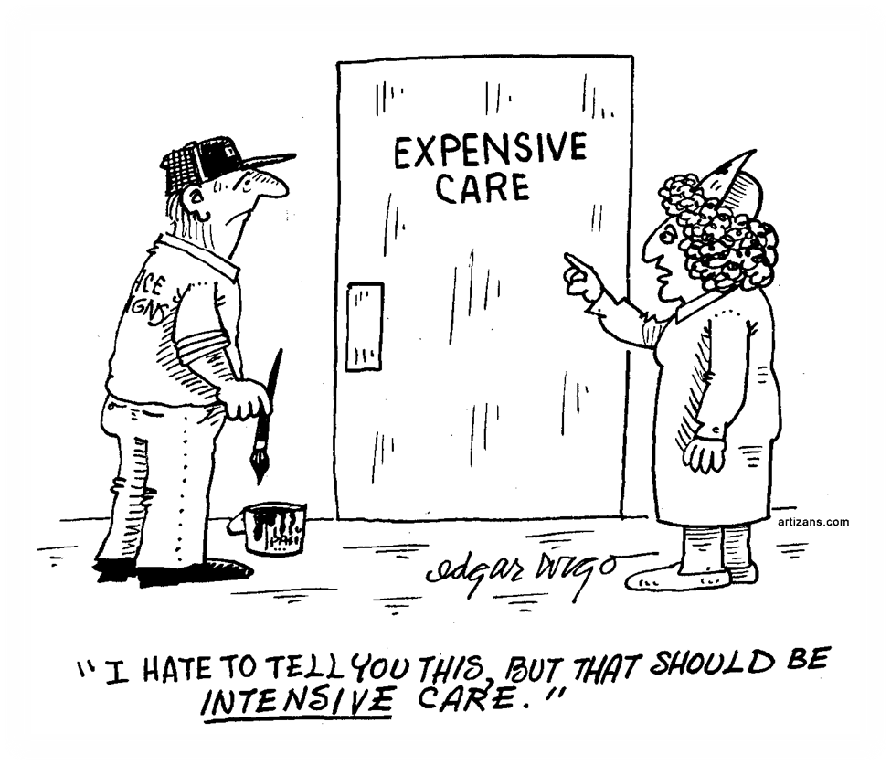
Notes:
So we talked about Medicare Part A, typically premium free, but we’ve also seen there is some out of pocket exposure. One of the biggest misconception for seniors is that they think when they get their Medicare, that Medicare pays for everything, but that’s just not the case!

Slide 14
True or False?
Medicare has an annual max out-of-pocket limit

Slide 15
True or False?
Medicare has an annual max out-of-pocket limit
FALSE
Notes:
Medicare does NOT have an annual max out of pocket limit, which means there is no safety net. This is another attractive feature of Medicare Advantage or Medicare Supplement plans – more predictable costs and an Annual Max out of Pocket limit.

Slide 16
Medicare 101
The standard monthly premium in 2024 is $174.70
Annual deductible is $240.00
80/20 coverage after deductible
Covers almost all reasonable and necessary medical services:
Doctors' services
Labs and X-rays
Ambulance Services
Emergency Room
Outpatient Services
Durable Medical Equipment
Notes:
Medicare Part B – unlike Part A, there typically is a premium for Part B, which usually gets deducted right from the SS check.
The annual part B premium is $174.70 for most people. Part B does have an ANNUAL deductible, and once you meet it,
you’re done with it for the year, unlike the Part A that has a Benefit period deductible.
In 2024 the Annual deductible for Part B is $240.00. This can increase each year.
Once you’ve met that Part B deductible of $240.00, then Part B coverage kicks in and
the 80/20 cost share kicks in. That’s how Part B works for the rest of the year.
I go in on January 3rd, pay the first $240.00 as a deductible, and then Medicare is going to pay 80% of the rest of the bills and the beneficiary is responsible for the other 20%.
Remember, there is no annual max out of pocket in the Medicare world. There is no safety net.
Doctor visits, lab work, x-rays, ambulance, air or ground, emergency room, outpatient services, durable medical equipment, including oxygen.
A lot more is done on an outpatient basis nowadays compared to the way it used to be.

Slide 17
Medicare 101
SERVICES NOT COVERED BY ORIGINAL MEDICARE:
Custodial care (bathing, dressing, continence and eating) at home or in a nursing home
Hearing aids and hearing exams
Routine eye care and most eyeglasses (with the exception of one pair of standard frames after cataract surgery)
Most dental care and dentures
Health care received while traveling outside of the United States
(except in limited cases)
Notes:
Medicare does not cover everything! Medicare does NOT cover custodial care, if you’re there to live out the rest of your days. That’s where long-term care insurance would be helpful to have, otherwise they have to spend down their assets, their savings, until they deplete that and go into Medicaid status.
Some other things Medicare doesn’t cover – hearing aids or exams, routine eye care, dental care & dentures., and healthcare while traveling outside the US.
Some of the advantage plans may have coverage for hearing aids or build in some dental care. Also, they will provide emergency coverage outside the US. They may give you some dollars towards eyeglasses.

Slide 18
How to Enroll in Medicare Part A & B
Medicare 101
Notes:
We talked about Medicare Part A, and Medicare Part B, now let’s talk about how to enroll.

Slide 19
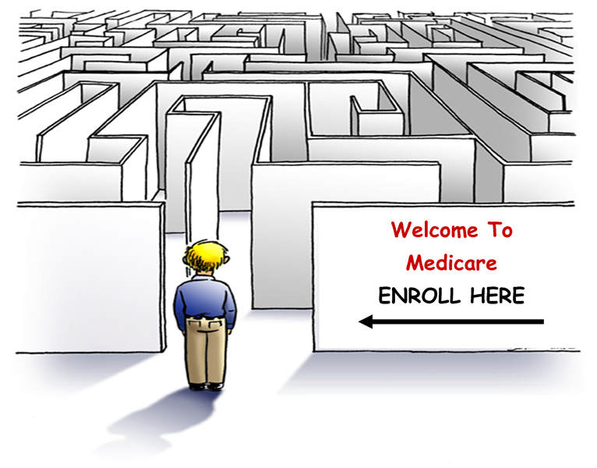
Notes:
This is what it looks like to most individuals when they are approaching Medicare eligibility. They may have a lot of misconceptions about what to do and when they should do it.

Slide 20
How to Enroll
ORIGINAL MEDICARE ENROLLMENT PERIODS:
Initial Enrollment - starts on the first day of the third month before the month you turn 65 and lasts seven months. Enroll through the Social Security Administration.
3 months before
the month you turn 65
2 months before
the month you turn 65
1 month before
the month you turn 65
The
month
you
Turn
65
1 month after
the month you turn 65
2 months after
the month you turn 65
3 months after
the month you turn 65
Notes:
The Initial Enrollment Period – the 7 month window when you are aging in. You have the 3 months before, the month of, and the 3 months after your 65th birthday to make an election, for a total of 7 months.
Example – I turn 65 in July of this year, so the earliest I can enroll is April, and the latest I can enroll is October. If I’m drawing SS, then this will happen automatically, my Medicare card will show up in the mail. But again, if I am waiting to draw SS, then I need to initiate this enrollment – online, in person, or over the phone.
Let’s say at age 65 I’m not ready to retire, I want to continue to work, I have medical coverage through my employer that’s creditable and I don’t want to enroll in Medicare yet – then I can choose to delay enrollment until a later date. Or, I’m retired but I’m married to someone who is still working and overs me under their employer plan, I can wait.

Slide 21
How to Enroll
ORIGINAL MEDICARE ENROLLMENT PERIODS:
Special Enrollment Period – allows an individual to enroll in Part B at a later date with no penalty. To be eligible, you must have been:
Enrolled in a group health plan continuously after age 65
You or spouse was actively working for that company
Must enroll within 8 months of your employment or coverage ending, whichever occurs first
Notes:
So now its 3 years later and I’m ready to retire and sign up for Medicare. So I call up Medicare and they say Alissa, where ya been? Your 68! And I say “well I continued to work, I wasn’t ready to retire yet and I had medical coverage through my company” and they’ll say okay great, you qualify for a Special Enrollment Period. This is for people who delayed their enrollment and want to sign up at a later date.
To be eligible, I must’ve been enrolled in a group health plan while under ACTIVE employment, mine or my spouses. Not COBRA or retirement coverage.
Must enroll within 8 month of your employment or coverage ending, whichever occurs first.
SS will mail out a verification form to the former employer to verify they had continuous creditable coverage during that time. That gets submitted, and the enrollment into Medicare will go through.

Slide 22
How to Enroll
ORIGINAL MEDICARE ENROLLMENT PERIODS:
General Enrollment Period – occurs from January 1 - March 31 of every year, with coverage beginning the month after enrollment. It is for individuals who:
Did not enroll during an Initial or Special Enrollment Period
Have dropped Part B and wish to re-enroll
10% penalty for every year you were eligible
Notes:
Here’s another scenario – I’m 68 and I call up Medicare SS and they say “Hey, where ya been? Your 68!” And I say “I didn’t need the coverage, I was healthy, didn’t want to take Medicare yet, I didn’t need it.” But now I need it because I’m sick. They’re going to say “you didn’t sign up for it during your initial enrollment period when you were first eligible, you don’t qualify for a Special Enrollment Period, you haven’t had continuous coverage during these past 3 years, so now you have to sign up during the General Enrollment Period, which only happens from January 1 – March 31 of the year.
It is for individuals who did not enroll in initial or special enrollment period, or who have dropped Part B and wish to re-enroll.
Let’s say someone does that today, January 15 and they sign up during their General Enrollment Period, their effective date would be February 1 for Part B.
The moral of this story is that you need to know your options and sign up at the right time. Pay attention to paperwork that you’re getting when you are approaching 65. Know your options if you plan to continue working. And you as the agent need to know these nuances so that you can advise your member’s the right way.
Here’s another scenario, although it doesn’t happen as often. When you start drawing SS, you will be automatically enrolled in Medicare A&B. But let’s say you plan on continuing to work and have medical coverage through your employer, but you’re still drawing SS for whatever reason. You can elect to waive the Part B enrollment and keep Part A. When you get your card, you will have the option of sending it back denying the Part B enrollment, and then you’ll get a new card with just Part A effective. That’s a scenario that you might run into where the Medicare card has different start dates for Part A and Part B.

Slide 23
Medicare 101
An alternative to Original Medicare
Sold by private insurance companies
Also called “MA” or “MA-PD” plans
Available across the country
If you purchase a Medicare Advantage plan the insurance company administers your benefits
The Medicare Part C premium varies by plan
You must continue to pay your Medicare Part B premium
Medicare Advantage Plans have to offer coverage at least as good or better than Original Medicare and typically offer extra coverage
Most Medicare Advantage Plans include prescription drug coverage (MA-PD)
Notes:
The third part to Medicare – Medicare Part C. If you buy a Medicare Part C plan, also known as Medicare Advantage, its an alternative to original Medicare and it becomes your Medicare plan. MA or MAPD. Sold by private insurance companies, and they would administer my Medicare benefits. So when I go to the doctor or hospital , I would just use my MA or MAPD card, not my original Medicare card. The carrier gets billed, not original Medicare. There is usually a monthly premium due with Part C plans, but it can also be $0. Whatever the premium, I do have to still continue to pay my Part B premium, on top of whatever Medicare Advantage premium I might have.
The coverage has to be at least as good, or above and beyond what original Medicare covers. That’s where those dental or vision benefits come in. It will also have a Max out of pocket so I’ll know that I have a safety net, and my expenses will be capped each year. It also builds in the prescription drug benefit if its an MAPD plan, so it’s a one-stop shop.

Slide 24
Medicare Part C – Medicare Advantage
Medicare 101
Network of doctors, hospitals and pharmacies
Predictable costs
Set copays
Annual maximum out-of-pocket
May cover other services like:
Wellness programs
Routine hearing, vision, dental
Fitness/Gym memberships
You can only join/leave Medicare Advantage plans during certain enrollment periods
Initial Enrollment Period
Annual Enrollment Period
Special Enrollment Period
Open Enrollment Period
Notes:
We can’t just buy a Part C plan based on premium alone – we have to look at “are my doctors covered? Is my hospital in the network?”
We will have some predictability. I don’t want 20% of an unknown amount, like with original Medicare. I want to know that I’ll pay a low co-pay when I go to the doctor.
MAPD plans also promote keeping you healthy, being proactive. They offer wellness programs and want to catch things early. Even offering free Gym memberships.

Slide 25
Types of Medicare Advantage
Health Maintenance Organizations (HMOs) require you to use health-care providers in a designated plan network and may require referrals from a primary care physician in order to see a specialist.
Preferred Provider Organizations (PPOs) recommend the use of “preferred” health-care providers in an established network, and these plans are likely to cover more of your medical costs if you stay inside that network. You don’t need a referral to see a specialist.
Private Fee-for-Service (PFFS) plans determine how much they will pay health-care providers, and how much the beneficiary is responsible to cover out-of-pocket.
Special Needs Plans (SNP) are tailored health insurance plans designed for beneficiaries with certain health conditions.
Notes:
MA Plans include HMO’s, PPO’s, similar to a group plan structure.
There are also PFFS, although not as common.
Special Needs Plans are those tailored to people living with
Chronic conditions such as diabetes, heart disease, certain
Cancers. There are also plans designed for people on Medicaid, coordinate
Benefits.

Slide 26
Medicare 101
You purchase and enroll in Part D through insurance companies
The Medicare Part D premium varies by plan
Part D plans will have a formulary and “tier” the drugs
4-5 tiers for most plans
Each tier is associated with a cost sharing amount
The lower the tier, the lower the cost sharing
Notes:
Now the 4th part of Medicare – Part D Prescription Drug Benefit. Again, like Part C we buy this from private insurance carriers.
There is a premium, which varies across plans and carriers. Part D plans will also have a formulary. What’s a formulary? A list of approved drugs. So again, you can’t just look at the premium, you have to look at the formulary – are my drugs included? And then they’re going to tier the drug. Typically, a plan has 4 – 5 tiers. Tier 1 being the lowest cost, generics, and tier 4 or 5 being those expensive brand name drugs or specialty drugs. The lower the tier, the lower the cost share, sometimes even $0 for generics.

Slide 27
Medicare Part D
Tier 1
$
Most generic prescriptions
Tier 2
$$
Preferred, brand name prescriptions
Tier 4
$$$$
Specialty, very high-cost prescriptions
Tier 3
$$$
Non-preferred, brand name prescriptions
Formulary: List of Covered Drugs
Drugs are grouped into tiers based on cost
In general, the lower the tier, the lower the cost
Deductibles may be charged by tier

Slide 28
Part D Coverage Gap: Donut Hole
Annual Deductible
Initial Coverage
Coverage Gap (Donut Hole)
Catastrophic Coverage
Coverage Stages
Up to $545 deductible
Up to $5,030 total drug costs
Up to $8,000 out-of-pocket costs
To end of year
Amount paid for prescriptions depends on stage
Dollar limits can change each year
Not all plans have a deductible
Many people never reach the coverage gap
Cycle starts over on January 1 each year
Notes:
Annual Deductible
Begins: with your first prescription of the plan year.
You pay the full cost of your prescriptions until your spending adds up to the amount of your deductible. So, if your plan has a $0 deductible, you skip straight to the next stage. Keep in mind that some deductibles may only apply to drugs on specific tiers, which means you may not have any deductible if you do not take any medications on those tiers. Any payments for your monthly premium or for medications on tiers that do not apply to the deductible are not counted toward reaching the deductible.
Initial Coverage
Begins: immediately if your plan has no deductible. Or, when the prescription payments you have made equal your plan's deductible.
Your plan pays for a portion of each prescription drug you purchase, as long as that medication is covered under the plan's formulary (list of covered drugs). You pay the other portion, which is either a copayment (a set dollar amount) or coinsurance (a percentage of the drug's cost). The amount you pay will depend on the tier level assigned to your drug.¹ This stage ends when the amount spent by you and your plan on your covered drugs adds up to equal the initial coverage limit set by Medicare for that year. In 2024 that limit is $5,030. Your monthly premium payments do not count toward reaching that limit.
Coverage Gap
Begins: when you and your plan have collectively spent $5,030 on your covered drugs.
Not everyone will enter the coverage gap (also referred to as the "donut hole"). In the coverage gap, the plan is temporarily limited in how much it can pay for your drugs. If you do enter the gap, you'll pay 25% of the plan's cost for covered brand-name drugs and 25% of the plan's cost for covered generic drugs.
Keep in mind that while the percentage you pay for brand-name drugs is lower, the price of that drug may be much higher than the generic option. Calculate the amount you would owe for each to see which one really offers the best cost savings for you.
You exit the coverage gap when your total out-of-pocket cost on covered drugs (not including premiums) reaches $8,000. Your out-of-pocket cost is calculated by adding together all of the following: yearly deductible, coinsurance, and copayments from the entire plan year, and what you paid for drugs in the coverage gap (including the discounted amounts you didn't pay in that stage).
Catastrophic Coverage
Begins: when your out-of-pocket costs reach $8,000 on covered drugs.
You exit the coverage gap when your total out-of-pocket cost on covered drugs (not including premiums) reaches $8,000. Your out-of-pocket cost is calculated by adding together all of the following: yearly deductible, coinsurance, and copayments from the entire plan year, and what you paid for drugs in the coverage gap (including the discounted amounts you didn't pay in that stage). You are now in the catastrophic phase and you won’t have to pay a co-payment or co-insurance for covered Part D drugs for the rest of the calendar year.

Slide 29
Medicare Prescription Drug Coverage
Fast facts:
Must be enrolled in Part A, Part B or both
May be required to use pharmacy network
Coverage and costs vary by plan and may change each year
Part D premium penalty for late enrollment may apply

Slide 30
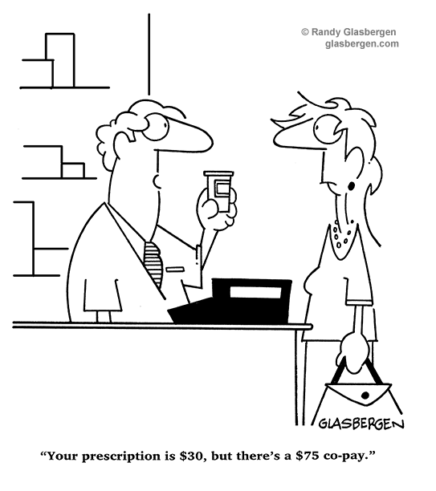
Notes:
Here’s a little humor, but in reality, drug costs can be VERY expensive, so its important that members have the right plan. You may run into a person who says “I don’t need Part D, I don’t take any drugs.” But if they have to start, this coverage can be invaluable.

Slide 31
Your Medicare Coverage Choices
Part A
Hospital Insurance
and/or
Part B
Medical Insurance
Part A
Hospital Insurance
Part B
Medical Insurance
OR
and
Original Medicare
Medicare Advantage Plan
Part C
Combines Part A and Part B and usually
Part D
You can add one or both
Medicare Supplement Insurance (Medigap) Policy.
Must have Part A and B
Part D
Prescription Drug Coverage.
Can have Part A and/or
Part B
Sometimes may add a Separate Part D Plan
Prescription Drug Coverage
(Most Part C plans cover prescription drugs. You may be able to add drug coverage to some plan types if not already included.)
Notes:
When someone becomes Medicare eligible either due to turning 65 or disability,
There are options for a wide demographic.
The choice depends on the needs of each individual.
Original Medicare (Parts A&B)
Part A helps cover hospital, skilled nursing, home health and hospice care
Part B is medical insurance for doctor visits, outpatient care and preventative
Services, occupational and physical therapies
To Part A & B, you can add a Medicare Supplement Plan,
Sometimes called Medigap Plans, these policies are written by
Private insurance companies to help cover some of the
Costs parts A&B don’t cover.
Then there’s a PDP or (Part D)
An optional prescription drug plan available from qualified private insurance
Companies. Since med supps don’t include prescription drug
Coverage, most people will need to add a stand-alone.
OR – there is
Medicare Advantage (Part C)
The same coverage as Parts A & B, plus some plans may
Include dental, vision and wellness programs AND they usually
Integrate the Part D coverage so in once nice, simple plan
And premium, you get both your original Medicare, along with a
Part D, and usually even some additional benefits.

Slide 32
Medicare Supplements - “Medigap”

Slide 33
Helps pay some costs not paid by Medicare
Supplements Original Medicare (Part A & Part B)
Can’t be used with a Medicare Advantage Plan (Part C)
10 plans with benefits standardized by the federal government
MA, MN and WI plans are different from standardized plans in other states
Plans offered by private insurance companies in your state

Slide 34
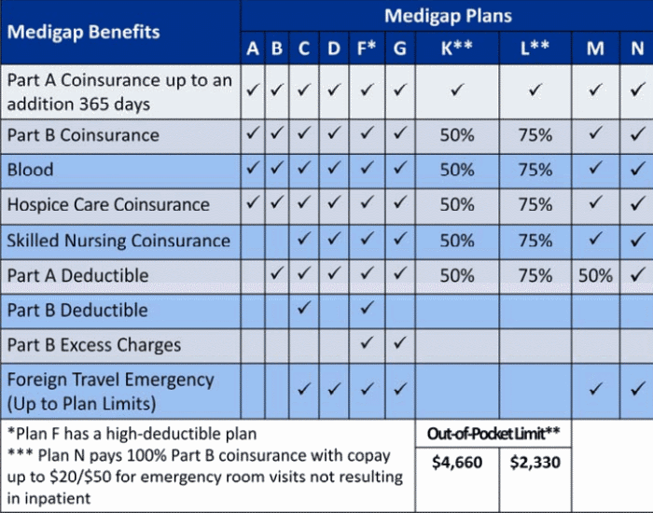
This Photo by Unknown Author is licensed under CC BY
Notes:
An example of the standardized med supp plans

Slide 35
Medicare Supplements – When to Enroll
If you decide to sign up for a Medigap policy, a good time to do so is during the Medigap Open Enrollment Period, a six-month period that typically starts the month you turn 65 and have Medicare Part B. If you enroll in a Medigap plan during this period, you can’t be turned down or charged more because of any health conditions. But if you apply for a Medigap plan later on, you may be subject to medical underwriting; your acceptance into a plan isn’t guaranteed.
Notes:
The best time to enroll in a Medicare Supplement plan is
In your 6 month Open Enrollment Period.
That starts the month you turn 65 and have Medicare Part B.
You will be guaranteed issue and have the lowest rate.
If you wait, you may be subject to underwriting if you enroll
At a later time, depending on your states. There are only a couple
Of states that are guarantee issue all the time.

Slide 36
What’s the Difference?
Medicare Advantage
Medigap
Usually has a network for the best cost-savings
Can include Part D coverage
Benefits can vary from plan to plan, but must be as good or better than Original Medicare
Guaranteed Issue
Subject to enrollment periods
Must be enrolled in Part A & B
Can go to any provider or facility who accepts Medicare assignment
Med supp plans sold today do not include Part D
Benefits are standardized across all plans. Premium varies.
May be subject to underwriting (check with your state)
Can enroll at any time of year
Must be enrolled in Part A & B
Notes:
These 2 plans do NOT work together. You cannot have a Medicare Advantage plan at the same
Time as a med supp.
Medigap has flexibility of doctor and hospital choice.
Medigap acceptance is Not guaranteed, unless you buy the plan during your
Medicare Supplement Open Enrollment Period or in another “guaranteed issue”
Period, or your state does not allow underwriting.

Slide 37
Enrolling in Medicare Advantage
Initial Enrollment Period (IEP)
If you enroll in the three months before your Medicare effective date at age 65, your plan effective date will be the first day of the month that Medicare is effective. Otherwise, the plan effective date will be the first of the month of your 65th birthday and only 3 months after.
If you have Medicare before age 65 due to a disability, you’ll have a second seven-month IEP at age 65 when you can change or enroll in a MAPD or PDP plan.

Slide 38
Important Dates
October 15 – December 7
Annual Election Period (AEP) for Medicare Advantage plans and prescription drug plans for the next calendar year.
Special Enrollment Period (SEP)
Generally, outside of the AEP, you can only make changes to your plan due to special conditions, like moving out of your plan’s service area, leaving an employer group plan, or having Medicare and Medicaid.
Medicare Advantage Annual Open Enrollment Period (OEP)
The Medicare Advantage OEP offers current MA and MAPD members a chance to change plans if they feel a more suitable option is available after January 1.

Slide 39
If it’s time to make your Medicare choice, consider these factors:
Cost – How much will you pay for premiums, deductibles, coinsurance and co-payments?
Needs – Have you needed care in the past few years? Do you anticipate your medicine needs will increase?
Benefits – Are additional benefits included, such as prescription drug coverage?
Providers – Do your doctors and preferred healthcare facilities accept the plan?
Convenience – Are the plan’s in-network providers conveniently located?
Notes:
Your Medicare needs are unique to YOU! Not your
Neighbor’s, your relative’s, or even your spouses!
There are many factors to consider -

Slide 40
Think about your needs over time
Your healthcare history
Do you have a chronic condition?
Will your healthcare needs grow in the near future?
Your prescription drugs
If your prescription drug spending increases in the future, Medicare Part D may help cover the cost.
Need more coverage than Medicare Part A & Part B?
A Medicare Supplement insurance plan or Medicare Advantage plan may help cover some unexpected healthcare costs.

Slide 41
Resources
Visit www.medicare.gov
Call 1-800-MEDICARE (1-800-633-4227), TTY 1-877-486-2048, 24 hours a day, 7 days a week
Call your State Health Insurance Assistance Program (SHIP); get the number at shiptacenter.org
Contact your local Social Security or state Medicaid office

Slide 42
Thank you for your time and attention today.
We hope this helps you as you consider your Medicare coverage choices.
<Insert Agent/RM name and contact info>

